Slide 1
Detection and Identification of Pool Balls using Computer Vision
Simon Have & Jesper Bækdahl

Slide 2
Agenda
Introduction
Table Detection
Human Interaction Detection
Ball Detection
Ball Identification
Test and Conclusion

Slide 3
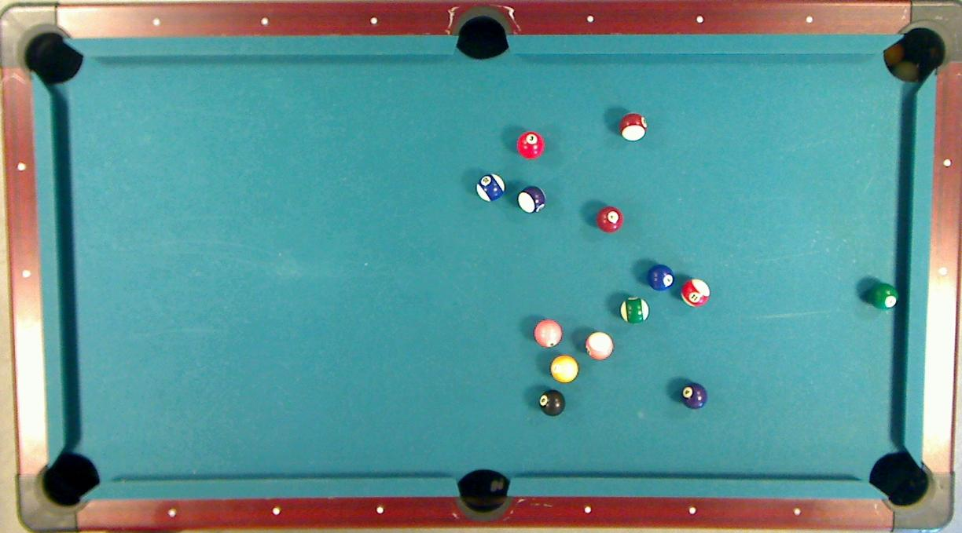

Slide 4
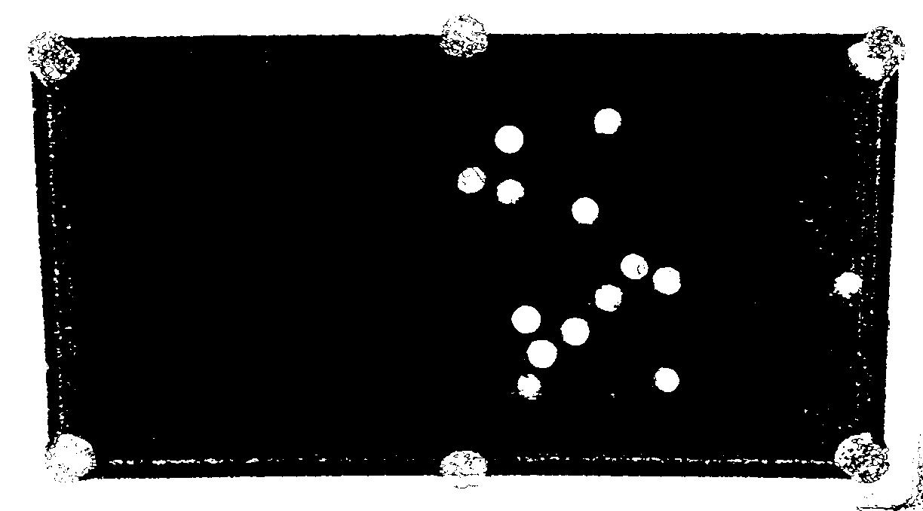
Ball Detection – Preliminary segmentation

Slide 5
Ball Detection – Probability estimation
24%
93%

Slide 6
Ball Detection – Best Candidates Selection
96%
98%

Slide 7
Ball Detection

Slide 8
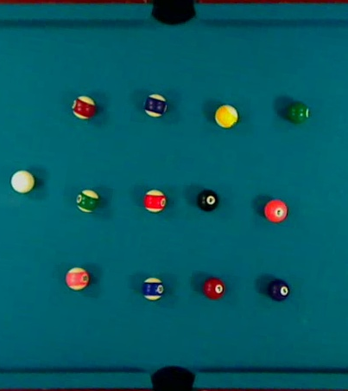
Ball identification - Calibration
Select Balls
Compute mean RGB

Slide 9
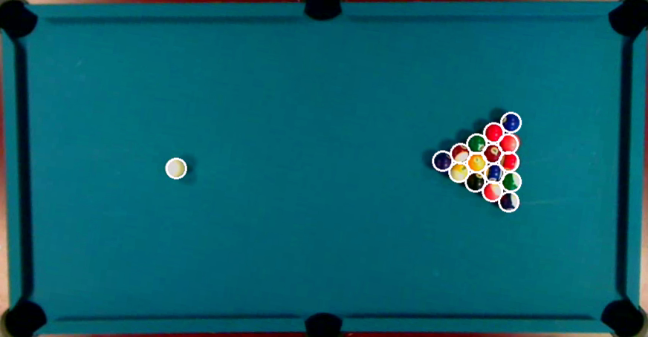
Ball Identification -

